Slide 1
Memory Management
Lecturer: Ngo Huy Bien
Software Engineering Department
Faculty of Information Technology
VNUHCM - University of Science
Ho Chi Minh City, Vietnam
nhbien@fit.hcmus.edu.vn

Slide 2

Objectives

Slide 3

Contents

Slide 4

References

Slide 5
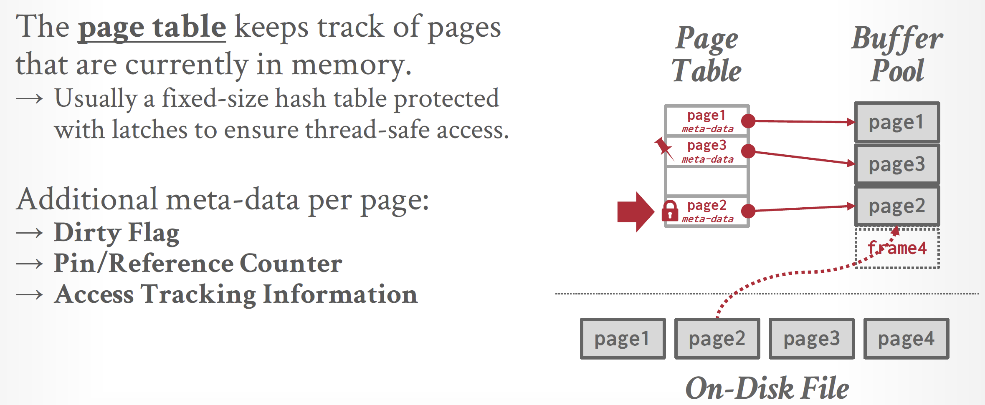
Page Table

Slide 6
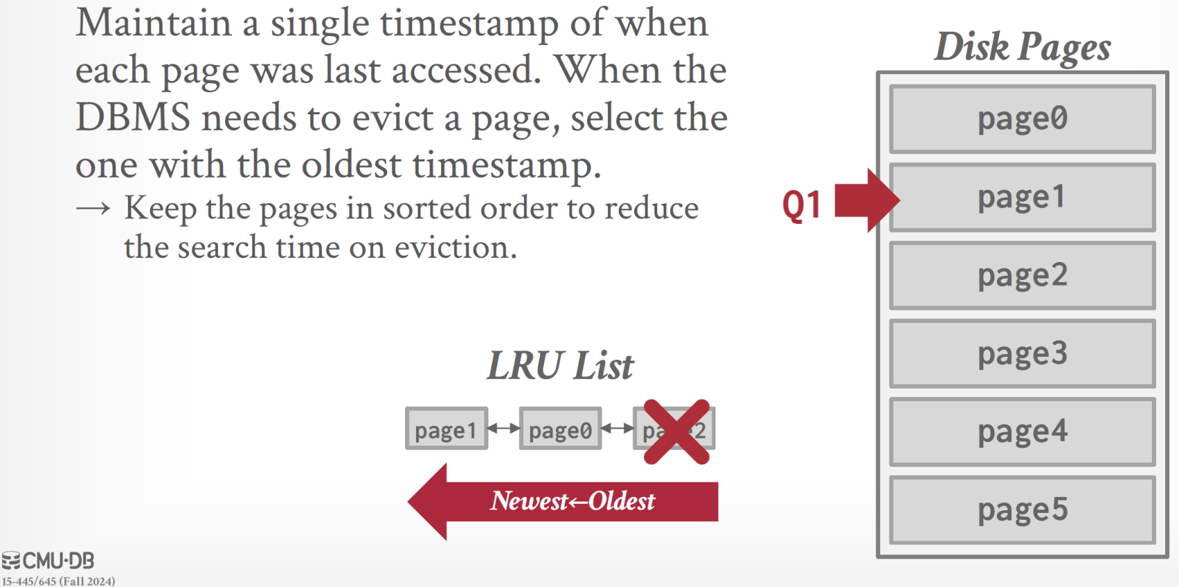
Least-Recently Used

Slide 7
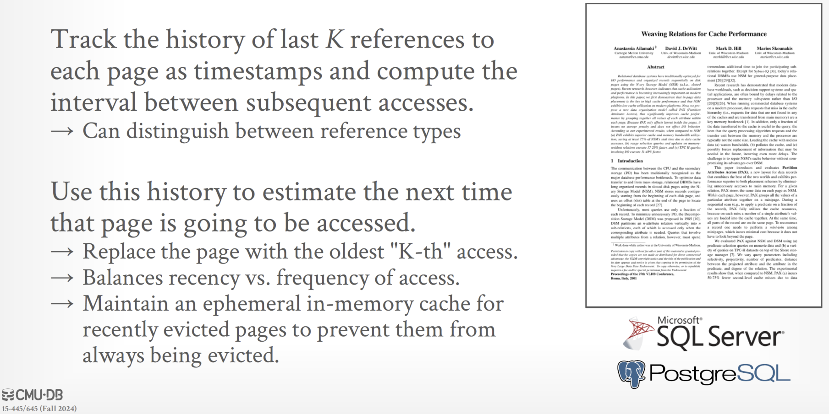
LRU-K

Slide 8


Slide 9

Thank You & See You Again

